Slide 1
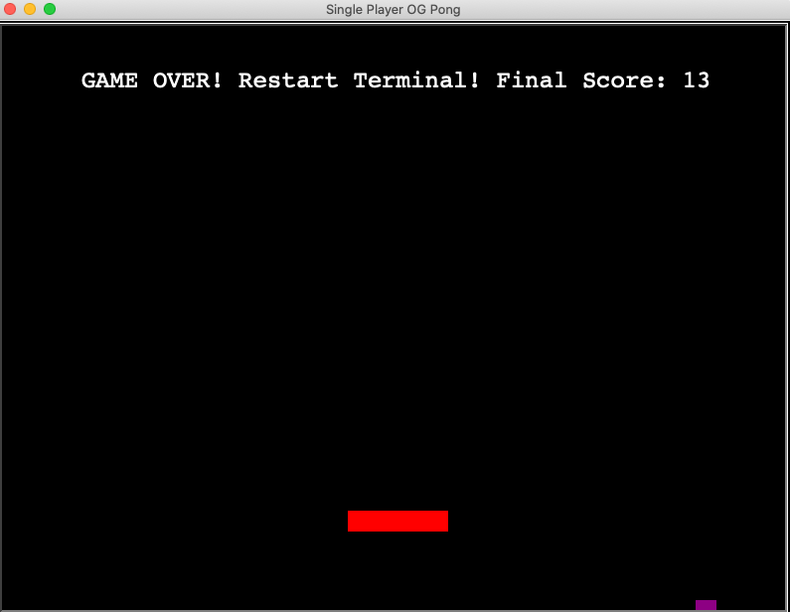
Single Player OG Pong
Project Coders: Owen Schuliger and Greg Allen
Our project URL: https://github.com/ksu-is/Pong-Arcade-Game-2.0/commit/4da37ae9c7dc3349c22d9c69296741cdf93af261
Original Code Source: https://github.com/ksu-is/Pong-arcade-game-
We took this single player Pong and added more functionality to make the game visually pleasing and more challenging. Our main concept was to keep the original look of Pong, but implement effects and color changes to the ball and paddle to keep the player interested in our fun, yet simple game.

